Slide 1

Group 1 Project for Adventure Works

Slide 2
This Project Contains the four tools:-
1. Excel :- Functions and Visualization
2. Microsoft Power Bi:- Dax functions and
Visualization
3. Tableau:- Calculation field with
Parameters and Visualization
4. MySql :- Query writing to understand
the data.
Project team,
1. Akarshan Srivastava
2. Kumar Partho
3. Hritik N Jaiswal
4. Shubham S Phatak
5. Rutuja Milind Kulkarni

Slide 3

Excel Project

Slide 4
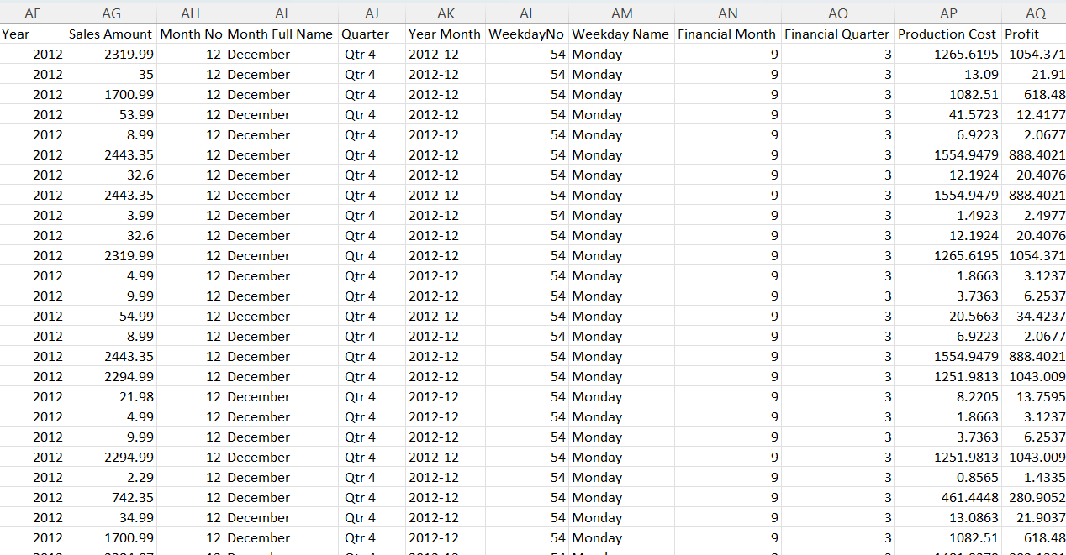
UNION (Fact Internet Sale and Fact Internet sales new)
Union was done by Combine function from the Power query
Creating Relationship between Sheets by adding all the sheet in one workbook by power query
→ Fact Internet Sales Sheet → Dimdate → Dim Product → DimProduct Sub Category → Dim product Category.
→ Fact Internet Sales New ➔ DimRegion → DimCustomer
Created some New Columns.
Vlookup :- Product Month Name ( into Union sales from dim product)
Year:- Extracted the year order date Key
Month:- Extracted the Month from the order date Key
MonthFullName:- Extracted the Month Name from the order date Key
Quarter:- Extracted the Quarter from the order date Key
Weekday No:- Extracted the Weekday no from the order date Key
WeekdayName:- Extracted the Weekday name from the order date Key
Financial month:- Extracted the Financial Month from the order date Key ( Financial Month Start from April)
Financial Quarter:- Extracted the year from the order date Key ( Financial Quarter start from April)
Sales Amount:- Created by multiplying (total order price x Order quantity) – Order Discount.
Total Production Cost:- Created by subtracting unit cost – Order quantity.
Profit:- Created by Subtracting Sales amount – Total production cost.

Slide 5
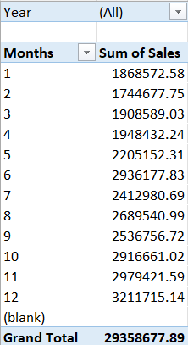
Created a pivot table with Month wise total sales.
We used Filters for year.

Slide 6
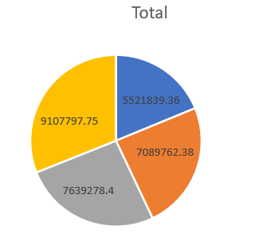
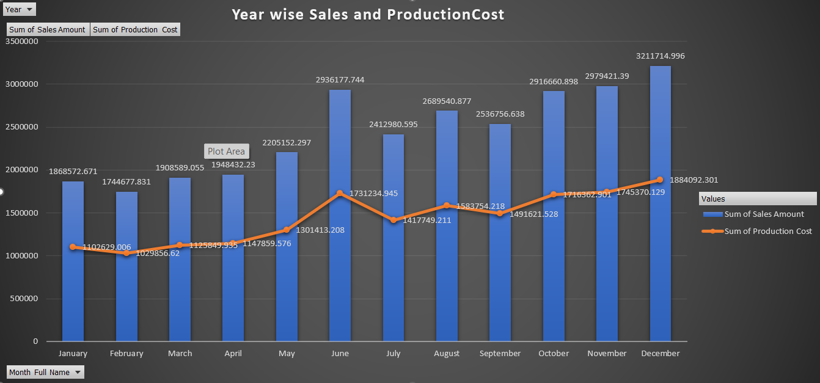

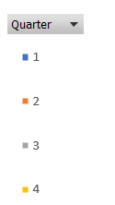
Creating a Combo Chart for Year wise total sales and total production cost.
Below is the data of month wise Sales and Total Production Cost. We used Filter on year to see year wise sales and total production cost
Created a pie chart for Qtr sales.
Used Filters for year.

Slide 7
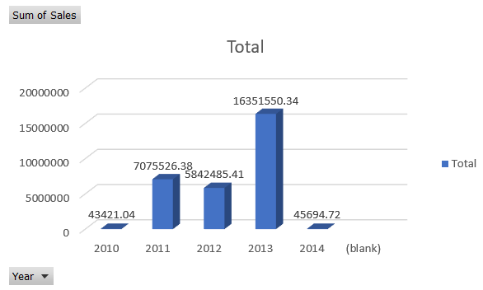
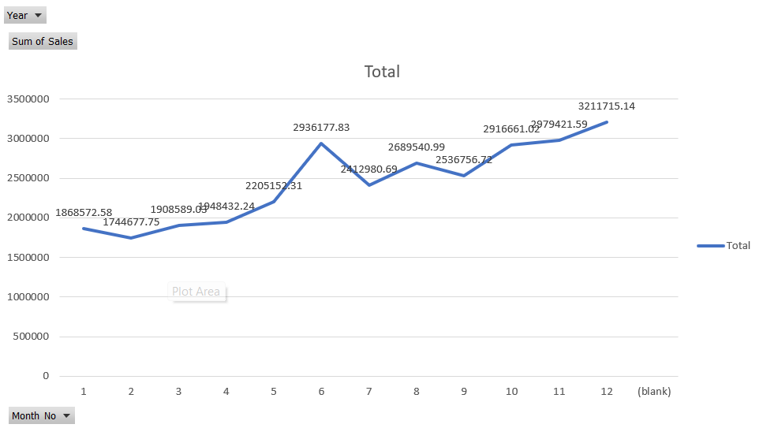
Created a bar chart for year wise total sales.
Created Line chart for Month wise sales
We used filters for year.

Slide 8
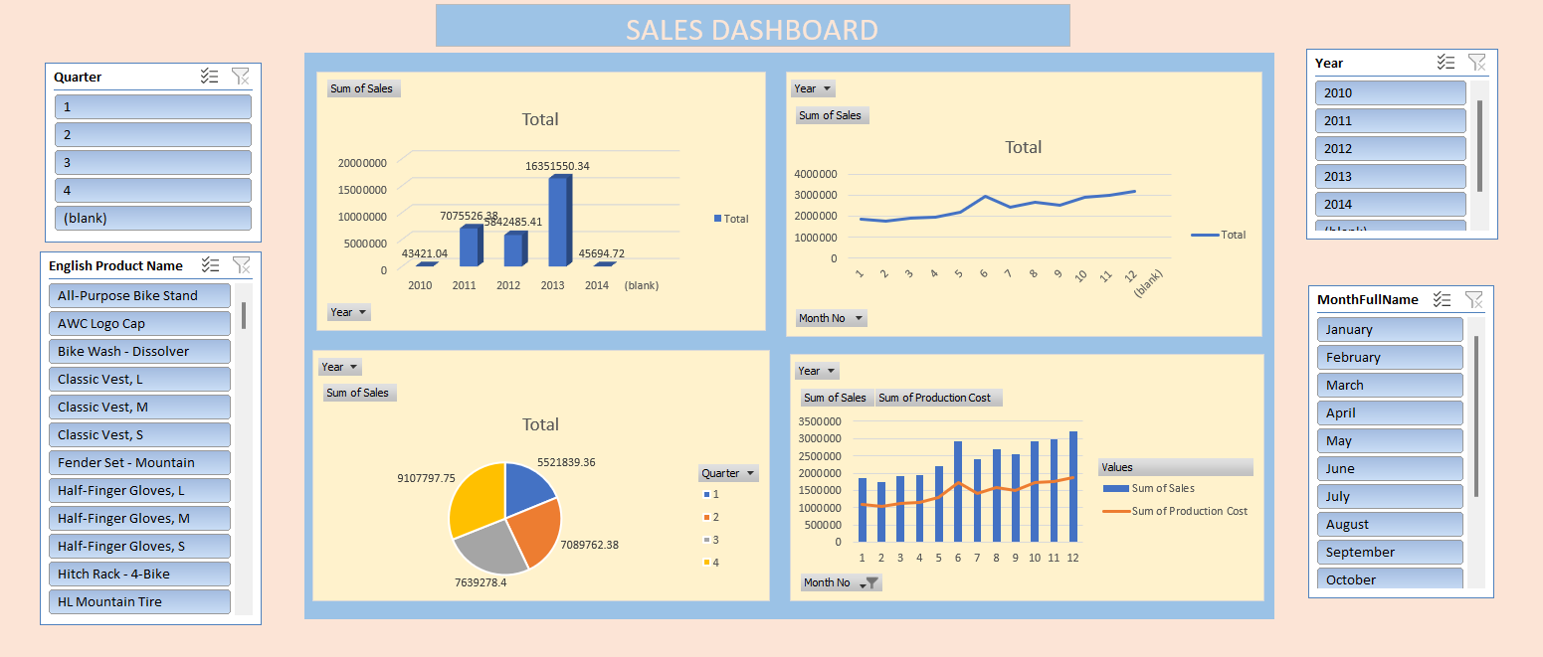
Sales Dashboard

Slide 9

Moving toward
Power Bi Project

Slide 10
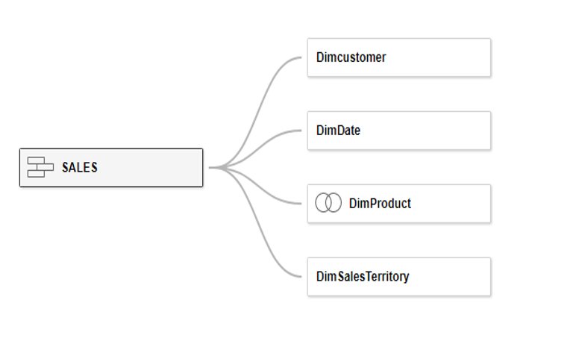
UNION (Fact Internet Sale and Fact Internet sales new)
Created a connection as shown below
Dimproduct is Left Join to DimProductSubCategory & DimProductCategory.
Created below Columns in the Dimdate table
Year :- Extracted the year from order alt date key
Month :- Extracted the month from order alt date key
Month Name :- Extracted the month name from order alt
date key
Month Short Name :- Extracted the month short name
from order alt date key
Calendar Quarter :- Extracted the Calendar quarter from
order alt date key
Weekday No :- Extracted the Weekday No from order alt
date key.
Weekday Name :- Extracted the Weekday name from
order alt date key
Weekday or weekend:- Created a field to check the
weekday and weekend.
Financial Month :- Extracted the Financial month from
order alt date key
Financial quarter :- Extracted the Financial quarter from
order alt date key
Year-Month :- Extracted the year-Month from order
alt date key

Slide 11
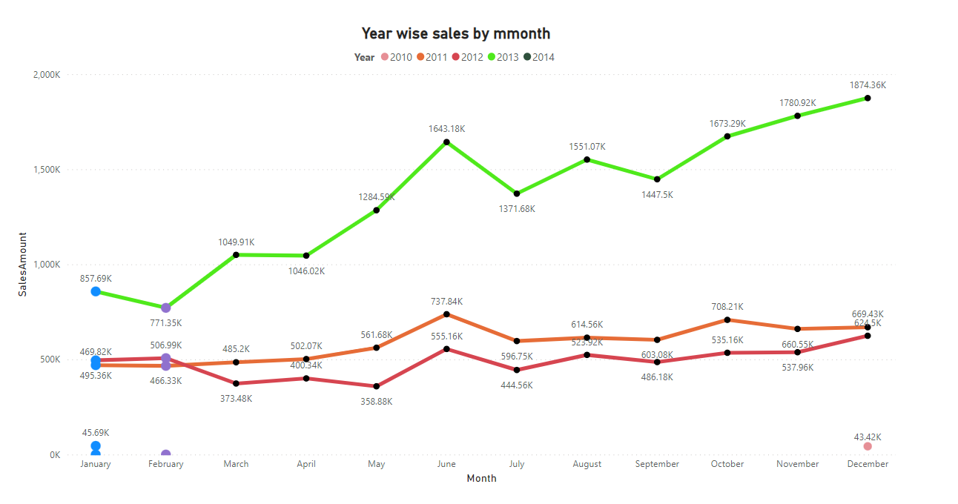
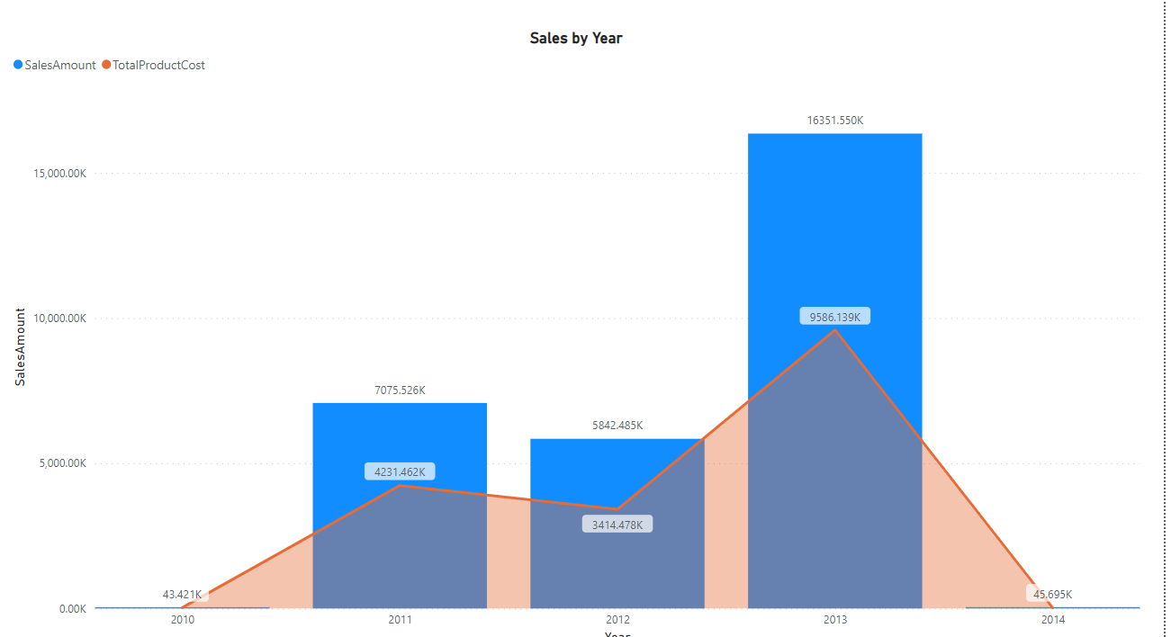
Created the Combinational Chart for year wise sales and total production cost.
Created Line Chart for year wise monthly Sales.

Slide 12
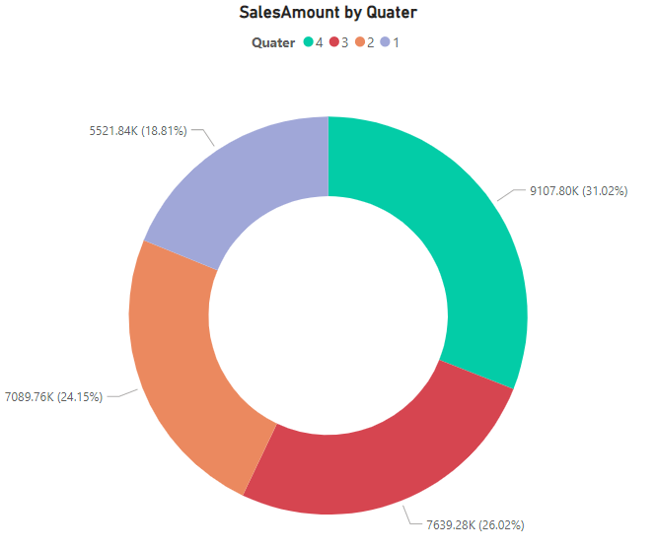
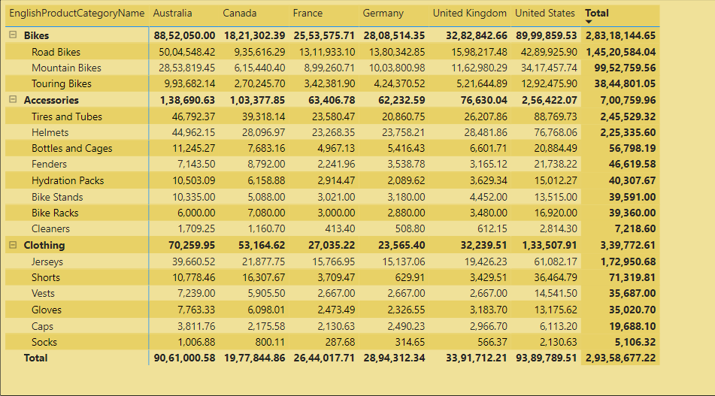
Created Donut Chart for Qtr wise sales.
Created a crosstab for Country wise product Cat and
Sub-cat sales.

Slide 13
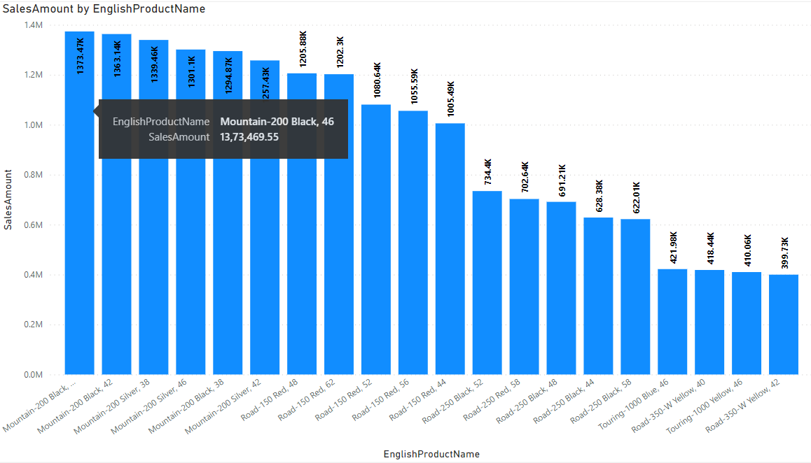
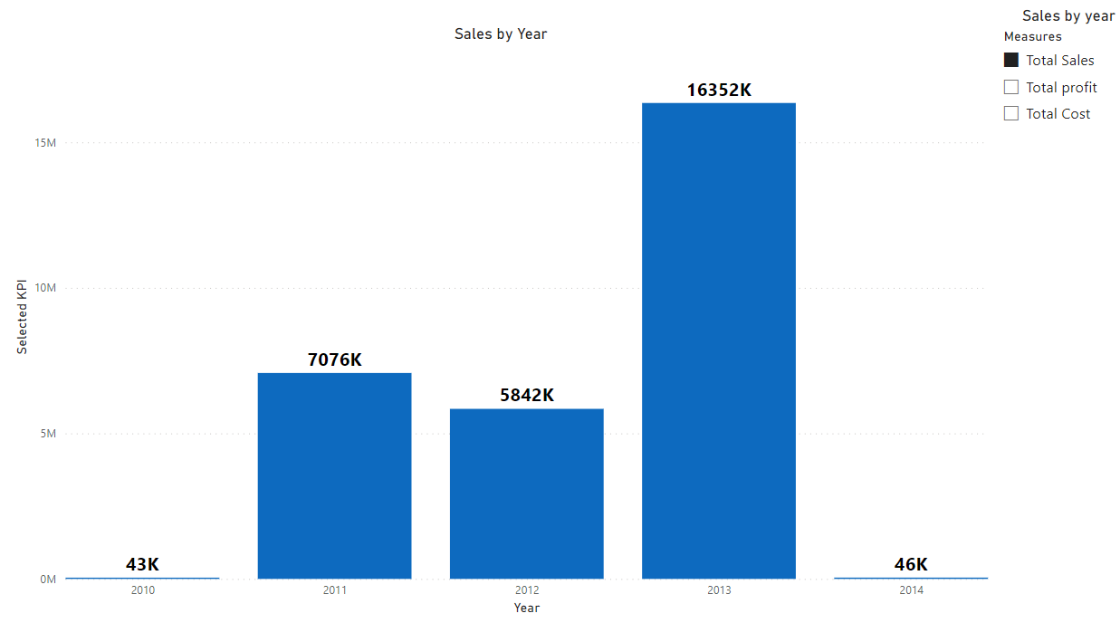
Created the Below Bar chart with the option for user to Switch between the SALES, COST, PROFIT.
Used filter for Sales , Cost and Profit on the visualization.
Created a TOP N chart as below using Parameter.
Used Filter for Top rating with interval of 5

Slide 14
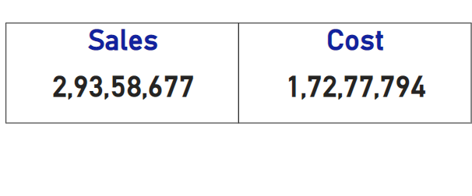
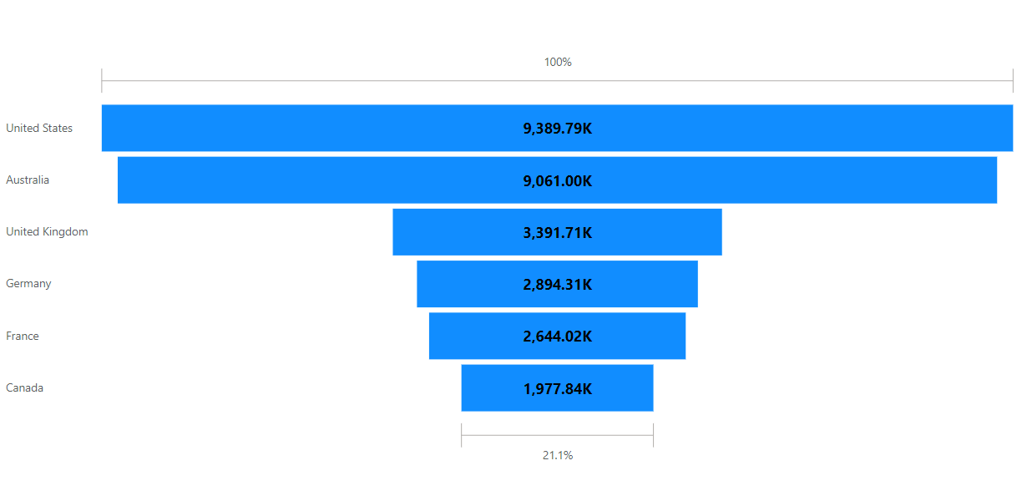
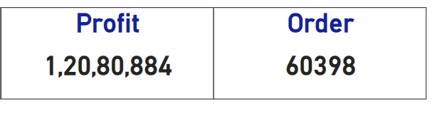
Created Advanced Funnel Chart for Country vs SalesAmount.
Created a KPI’s for worksheet.

Slide 15
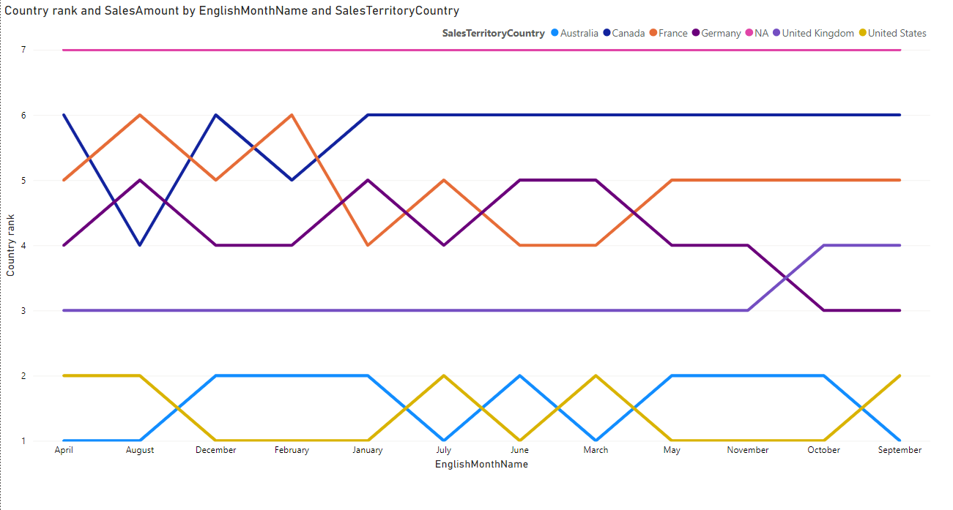
Created Bump Chart for English Monthname , Salesterritory Country and Sales Rank.

Slide 16
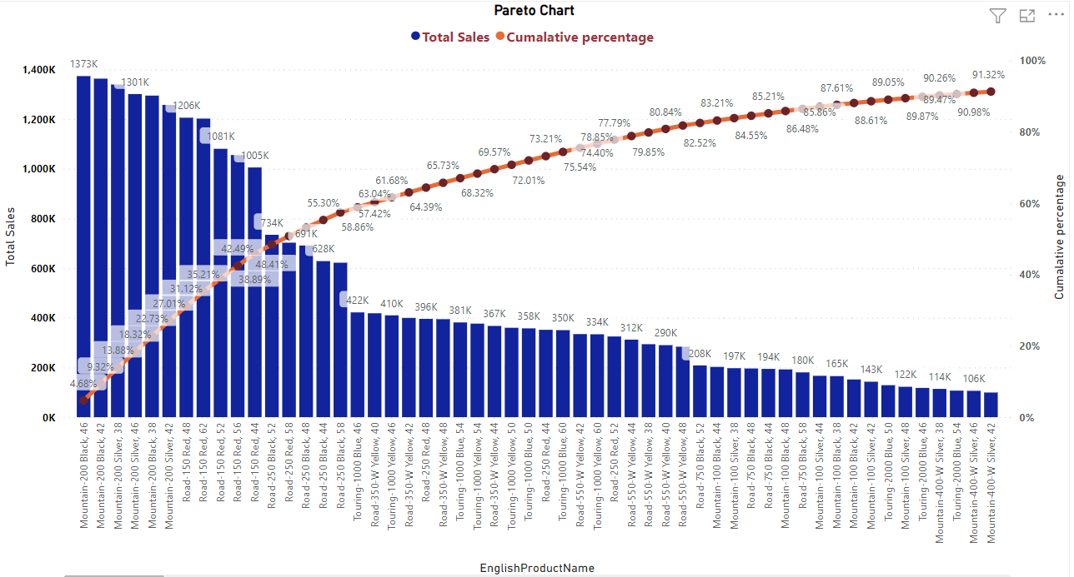
Created a Pareto Chart for English Product Name and Sales Amount.

Slide 17
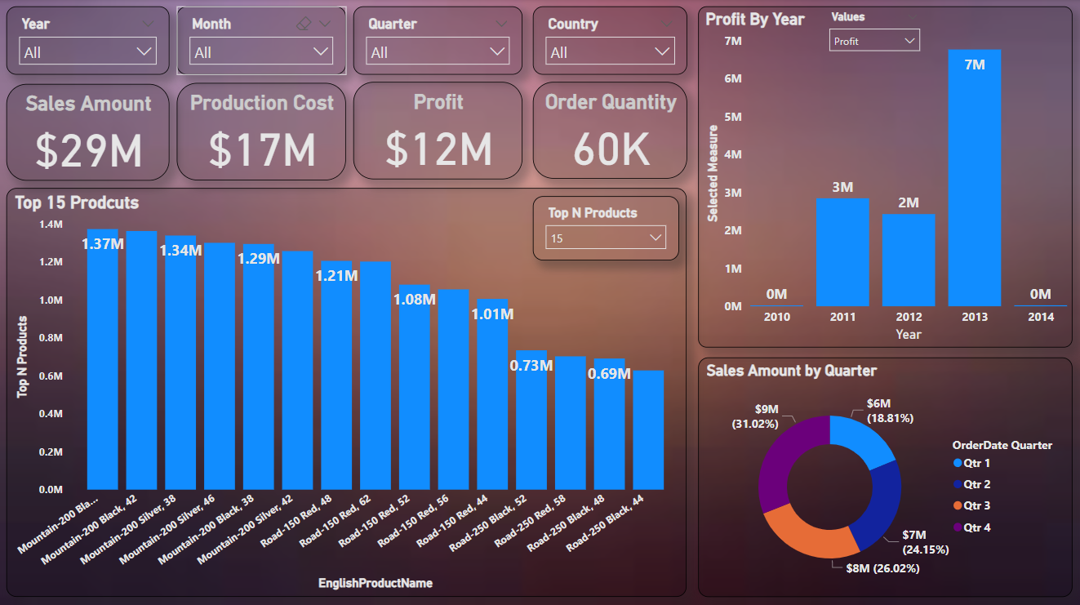
Sales Dashboard

Slide 18

Moving toward
Tableaue

Slide 19
UNION (Fact Internet Sale and Fact Internet sales new)
Created a connection as shown below
Dimproduct is Left Join to DimProductSubCategory & DimProductCategory.
Created below Columns in the Dimdate table
Year :- Extracted the year from order alt date key
Month :- Extracted the month from order alt date key
Month Name :- Extracted the month name from order alt
date key
Month Short Name :- Extracted the month short name
from order alt date key
Calendar Quarter :- Extracted the Calendar quarter from
order alt date key
Weekday No :- Extracted the Weekday No from order alt
date key.
Weekday Name :- Extracted the Weekday name from
order alt date key
Weekday or weekend:- Created a field to check the
weekday and weekend.
Financial Month :- Extracted the Financial month from
order alt date key
Financial quarter :- Extracted the Financial quarter from
order alt date key
Year-Month :- Extracted the year-Month from order
alt date key

Slide 20
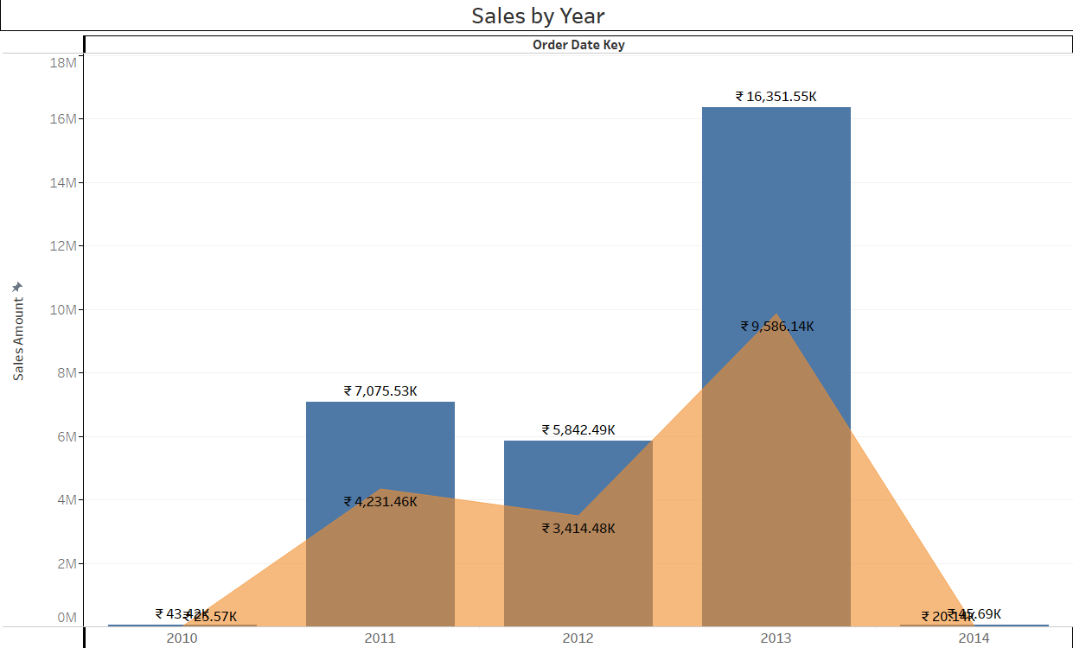
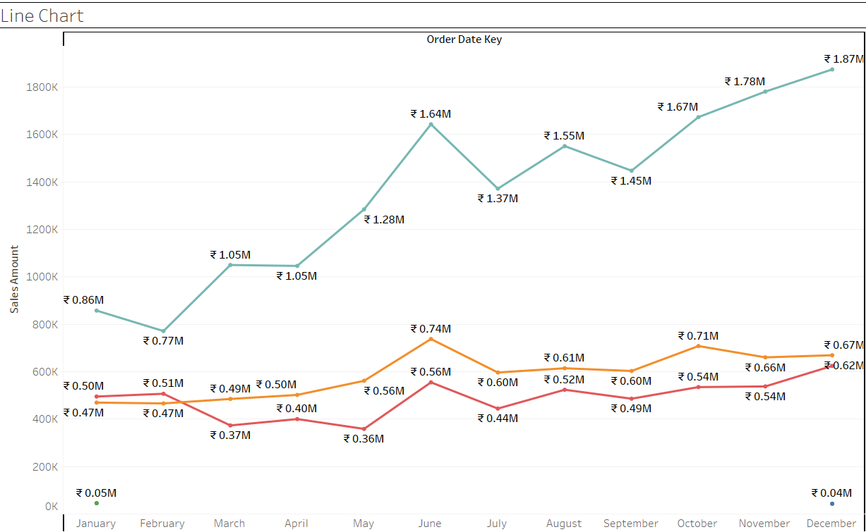
Created the Combinational Chart for year wise sales and total production cost.
Created Line Chart for year wise monthly Sales.
Used Filter for year.

Slide 21
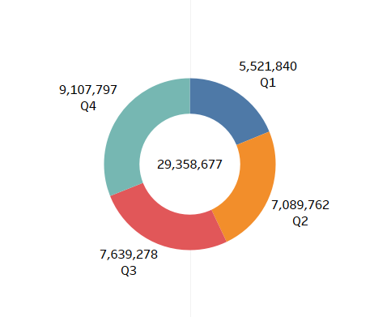
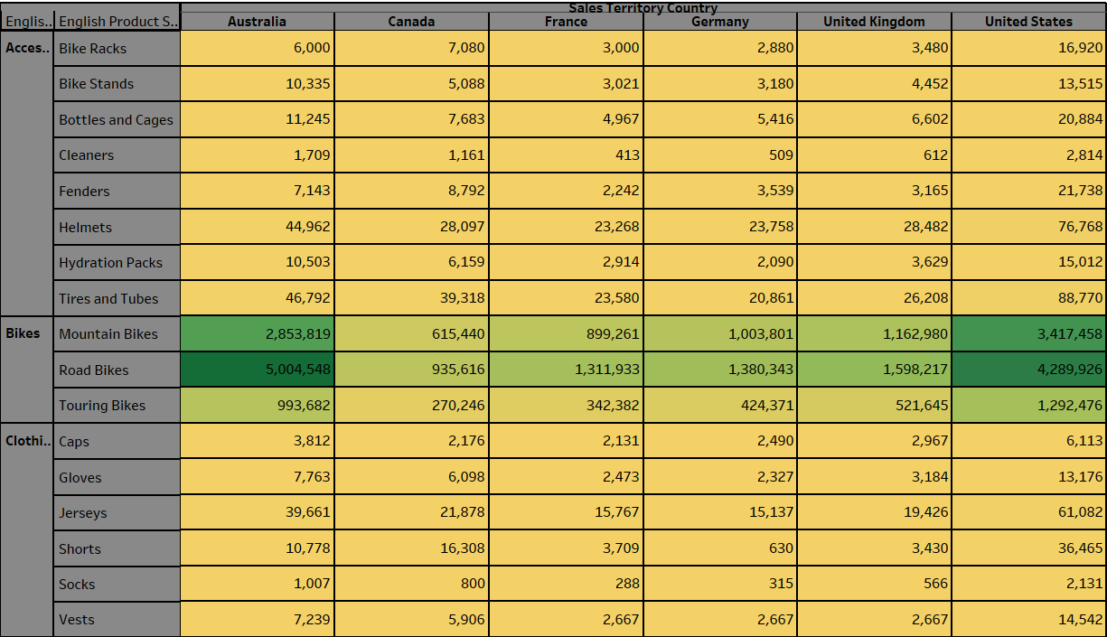
Created Donut Chart for Qtr wise sales.
Created a crosstab for Country wise product Cat and
Sub-cat sales.

Slide 22
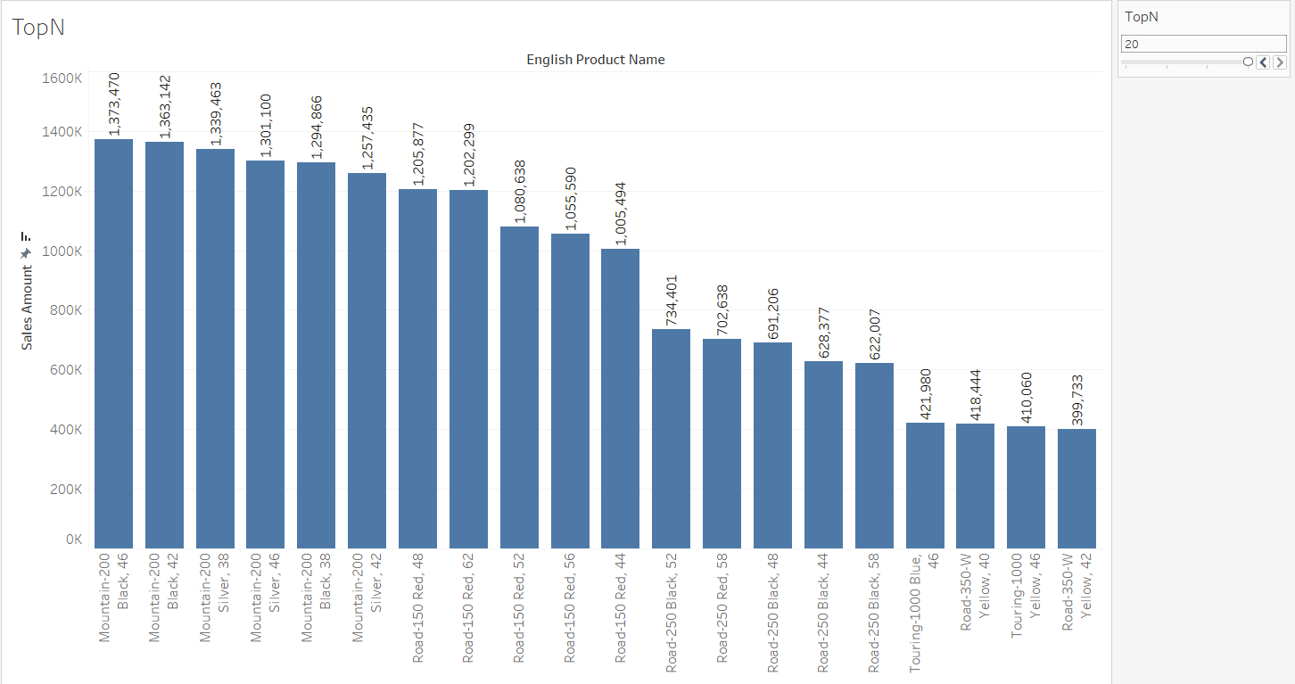
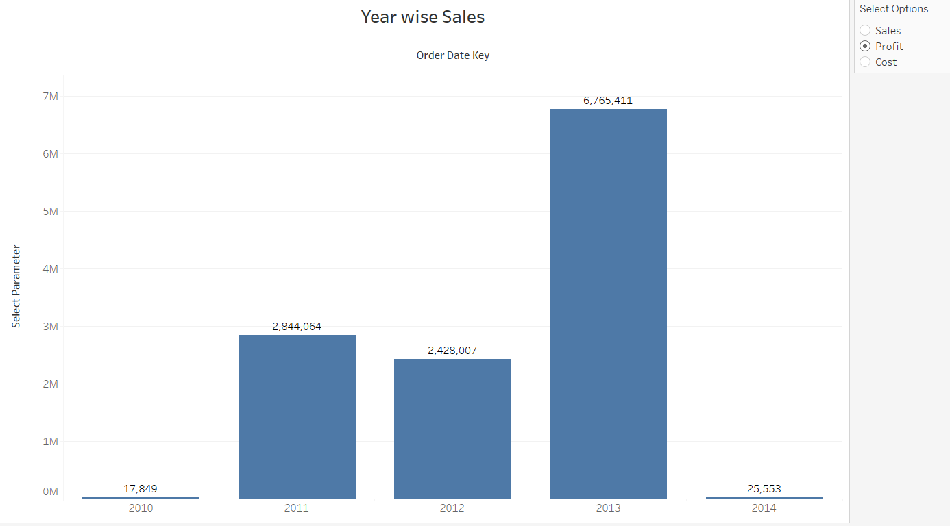
Created the Below Bar chart with the option for user to Switch between the SALES, COST, PROFIT.
Used Filter for Sales , Cost and Profit
Created a TOP N chart as below using Parameter.
Used filter for Top rating with interval of 5.

Slide 23
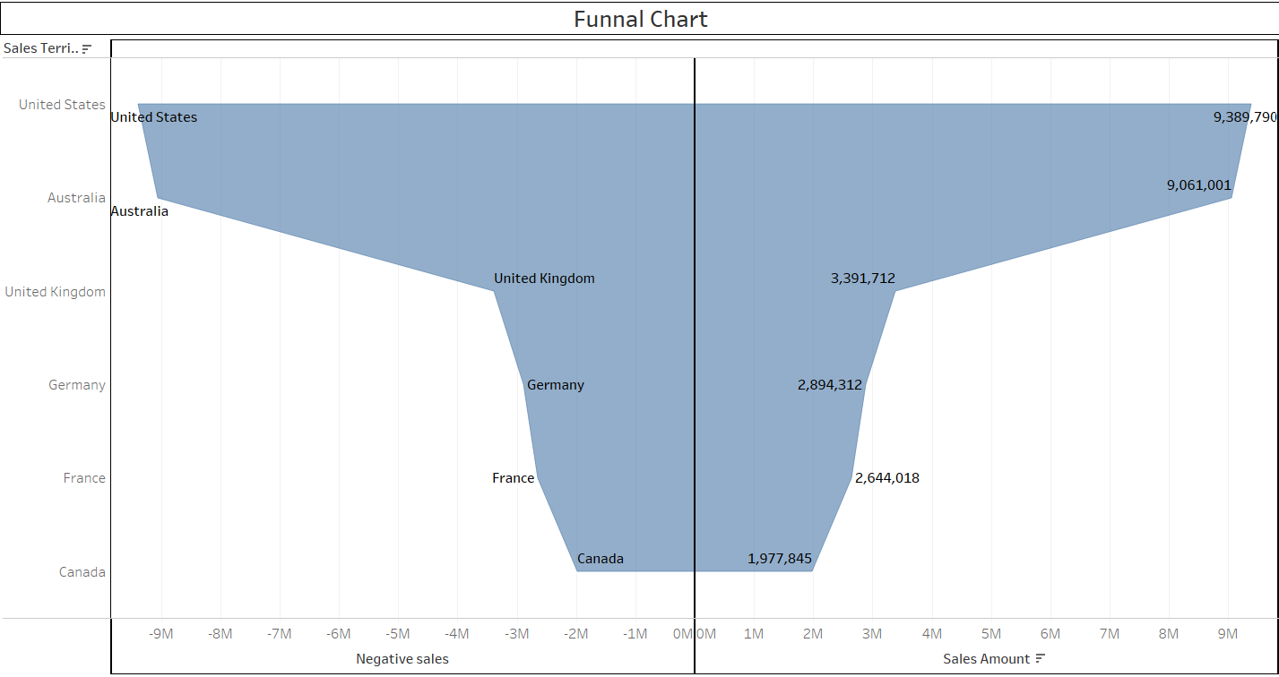
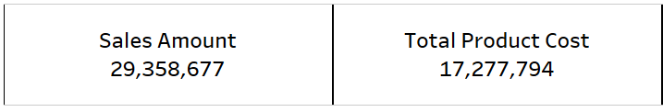

Created Advanced Funnel Chart for Country vs SalesAmount.
Created a KPI’s for worksheet.

Slide 24
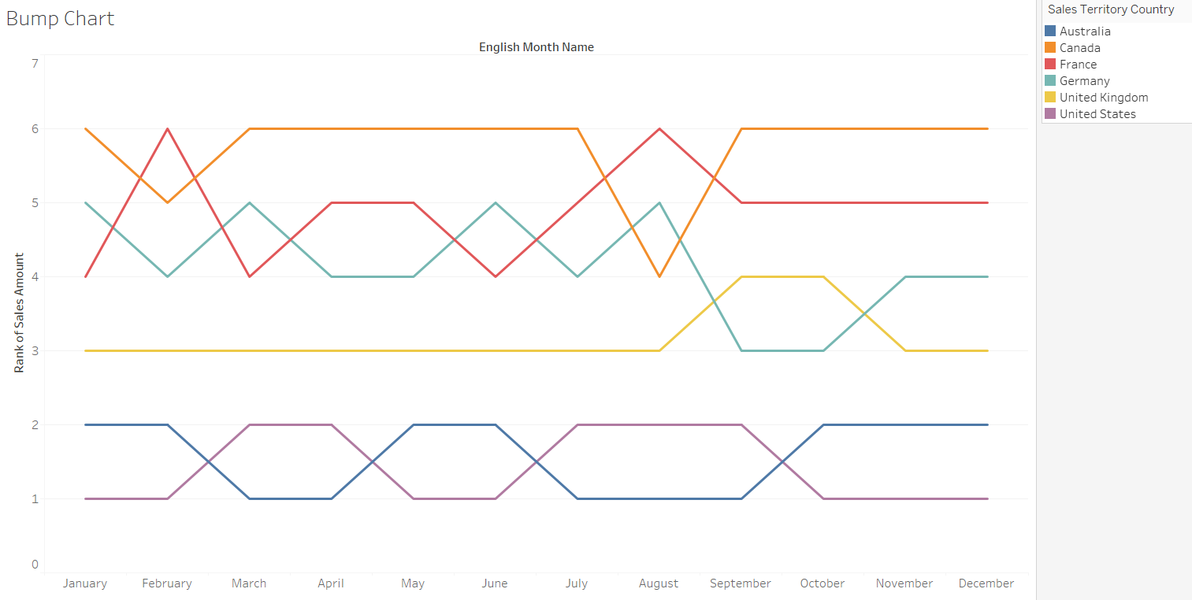
Created Bump Chart for English Monthname , Salesterritory Country and Sales Rank.

Slide 25
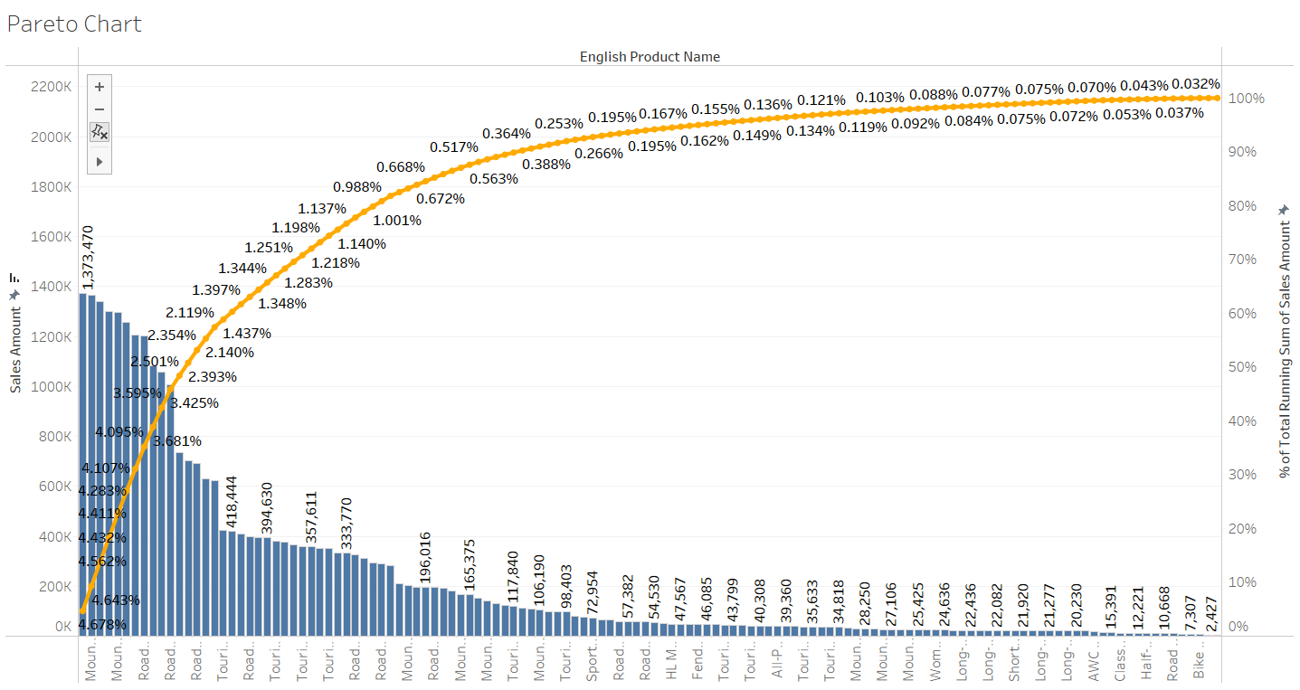
Created a Pareto Chart for English Product Name and Sales Amount.

Slide 26
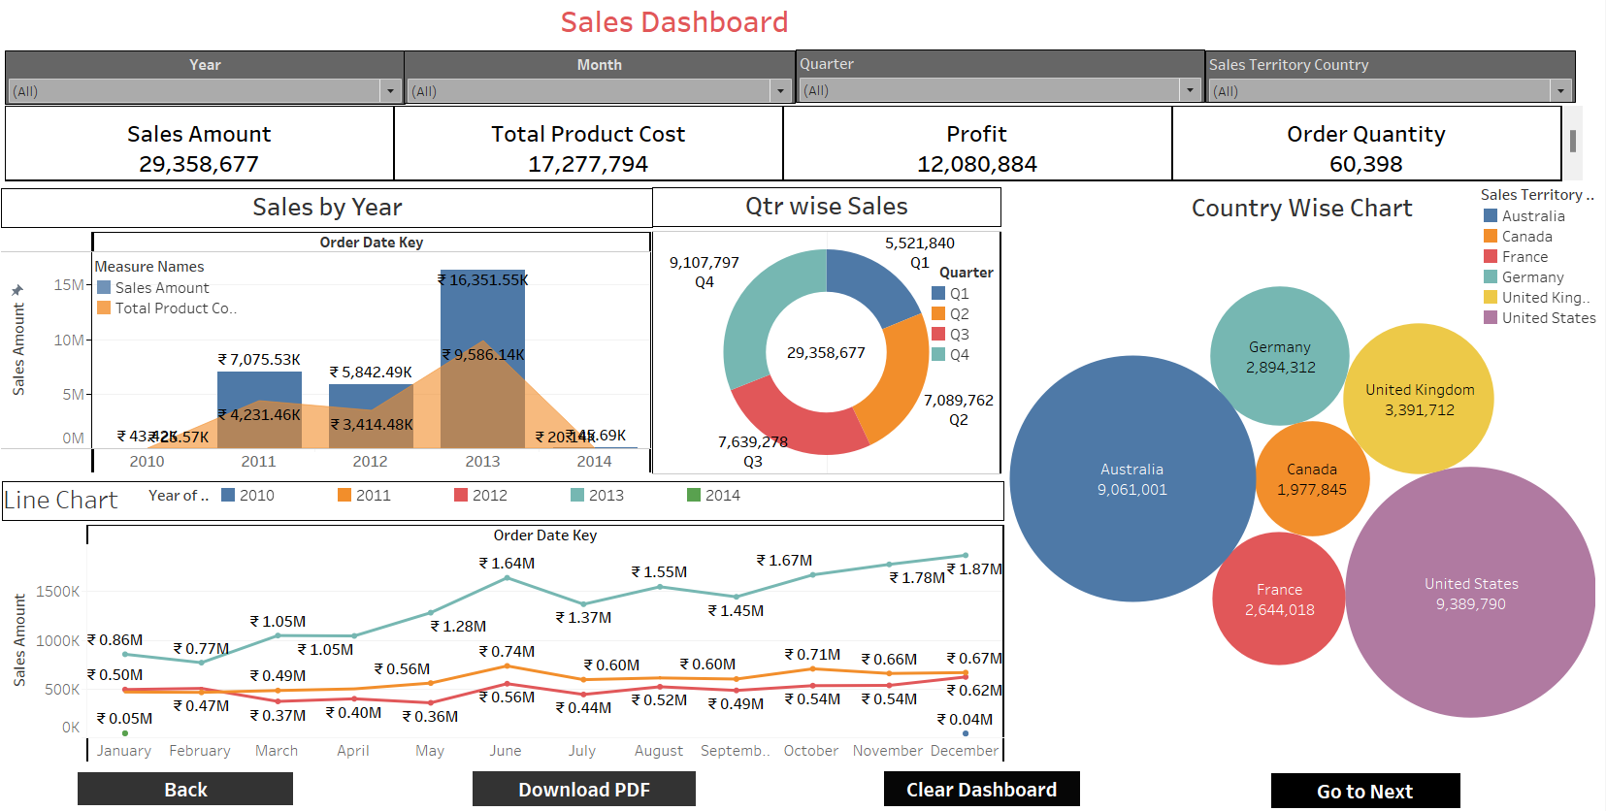
Sales Dashboard

Slide 27

Moving toward
MySQL

Slide 28
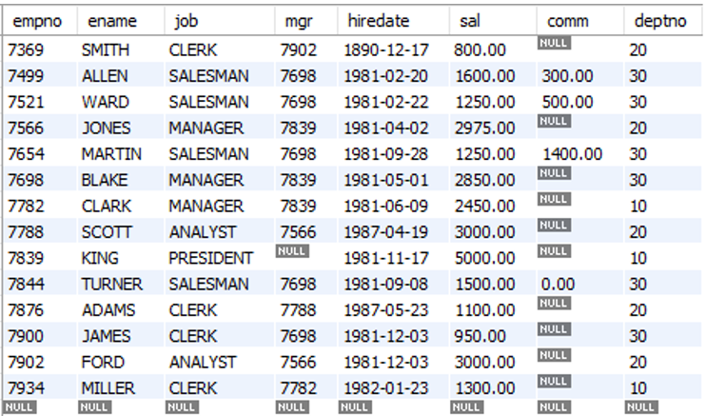
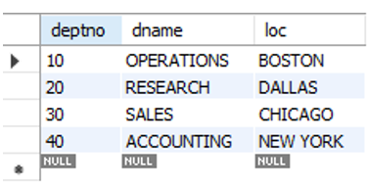
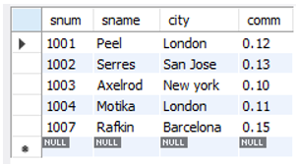
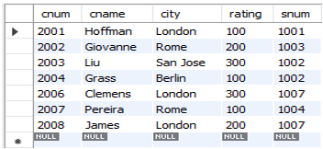
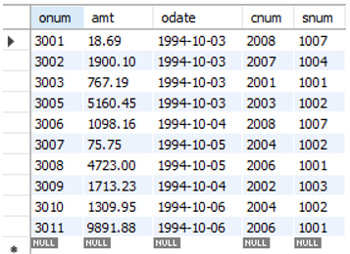
Created below mentioned tables:-
Employee table
Cust table
Salesperson table
Customer table
Orders table

Slide 29
Performed few query to show the make the data more understandable like:-
List the Names and salary of the employee whose salary is greater than 1000
List Employee Names having I as second character.
Determine total payable salary of salesman category
Display the last name, salary and Corresponding Grade.
Display Empname and Total sal where Total Sal (sal + Comm)
Display Empname , Rank of sal in Organisation , Rank of Sal in their department
Write a query to match the salespeople to the customers according to the city they are living.
Write a query that finds all pairs of customers having the same rating
Write a query that produces all pairs of salespeople who are living in same city
Write a Query to find all orders attributed to salespeople in London.
Write a query to count customers with ratings above San Jose’s average rating.
Write a query that lists each order number followed by name of customer who made that order

Slide 30
Thank you
Team Group 1

